Slide 1

Natural Language Queryable Data Pipeline
Presented by
Devadi Yekaditya
Mislah Rahman
Sriramsetty Bhanu Teja
Under the guidance of
Dr. Amit Ranjan Azad
INDIAN INSTITUTE OF INFORMATION TECHNOLOGY KALYANI

Slide 2





Introduction
Data Acquisition
Conclusion
Information Retrieval
Information Extraction

Slide 3

Data Acquisition
Information Extraction
Introduction
Conclusion
Information Retrieval

Slide 4

Information Extraction
Data Acquisition
Information Retrieval
Introduction
Conclusion

Slide 5

Information Retrieval
Information Extraction
Conclusion
Data Acquisition
Introduction

Slide 6

Conclusion
Infromation Retrieval
Introduction
Information Extraction
Data Aquisition

Slide 7

Introduction
Extract large scale data from websites as user requirements
AI based:
More flexible
User can setup and query with minimal technical knowledge

Slide 8

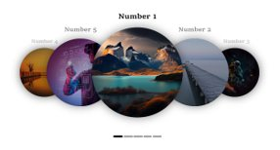
Scraping
Definition:
Web scraping is the process of extracting data from websites.
Tools:
Scrapy is used to process the request and extra data.

Slide 9
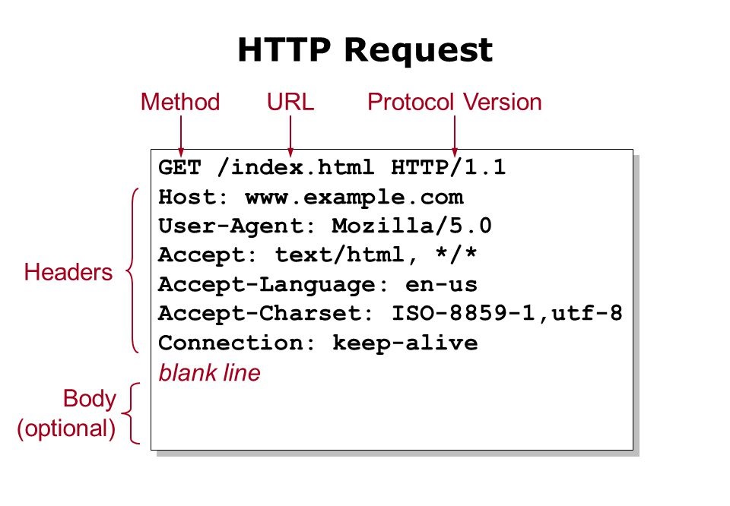
HTTP Requests
A specified standard format to request web servers.
Browsers request in the format to get web data
Scrapy simulate web request by introducing itself as a browser

Slide 10

HTML and DOM Structure
HTML:
Hyper Text Markup Language
Use
DOM:
HTML is processed as a tree of elements in programming languages

Slide 11
Parsing
To obtain the useful information from the DOM.
We use XPath and CSS Selectors

Slide 12

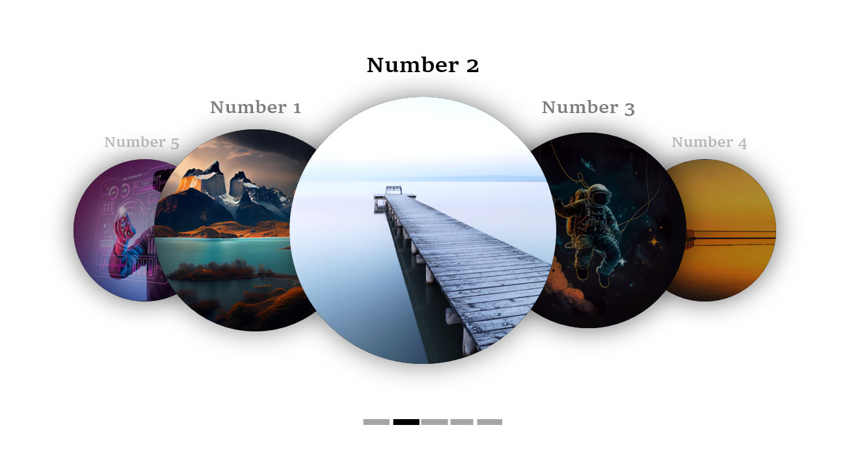
DOM destructuring
While extracting the data from webpage, we keeping the DOM structure intact.
It brings redundencies and unwanted nesting
Remove classes that doesn't contains text data

Slide 13

Information Extraction (IE)
Extracting structured information from unstructured or semi-structured text data.
To identify and classify key entities, relationships, and events from text and organize them into a structured format.

Slide 14
NLP Tasks involved in Information Extraction
Named Entity Recognition (NER)
Parts of Speech (POS) Tagging
Chunking

Slide 15
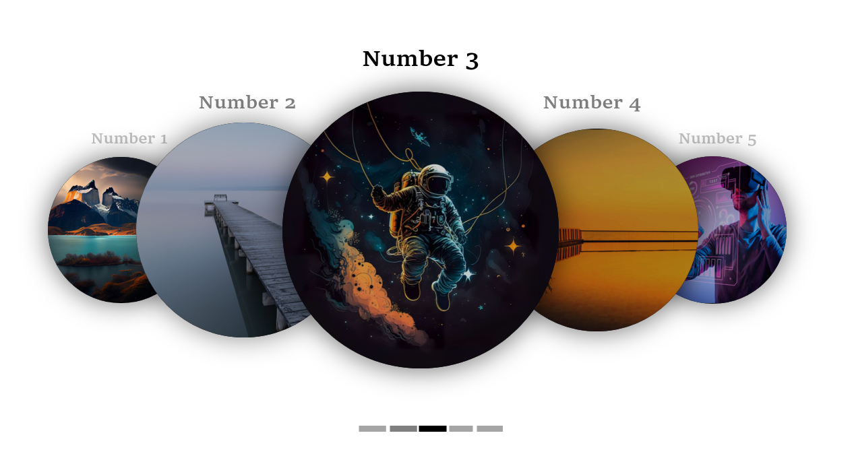
Relation Extraction:
Identifying and classifying relationships between entities, such as marriage, employment, and location.
Enriches extracted information and provides a deeper understanding of the text.
Event Extraction:
Identifying and classifying events in text, such as meetings, conferences, and product releases.
Provides structured information about the occurrence of events and their participants.

Slide 16
Text Normalization: Clean and prepare text data.
Tokenization: Break down text into individual tokens.
Stop Word Removal: Remove common words with little semantic meaning.
Stemming/Lemmatization: Reduce words to their base forms or lemmas.
Vocabulary Creation: Create a dictionary of unique tokens and assign numerical identifiers.
TF-IDF: Calculate the weight of each token based on its frequency and rarity

Slide 17
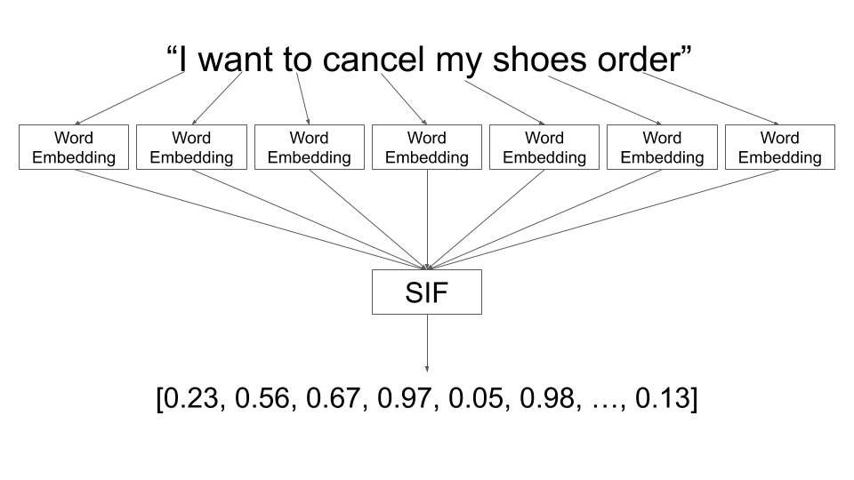

Slide 18

Information Retrieval (IR)
Information retrieval (IR) is the field of computer science concerned with the process of searching for, retrieving, and ranking information relevant to a user's query. IR systems are designed to help users find the information they need quickly and efficiently from a large collection of documents.

Slide 19
Several NLP tasks are essential for effective IR:
Natural Language Understanding (NLU):Understand user query intent and identify key concepts.
Information Extraction (IE): Extract structured information from text, including entities, relationships, and events.
Relevance Ranking: Determine document relevance to the query based on content, structure, and popularity.
Query Reformulation: Expand or refine the user's query to enhance retrieval results.

Slide 20
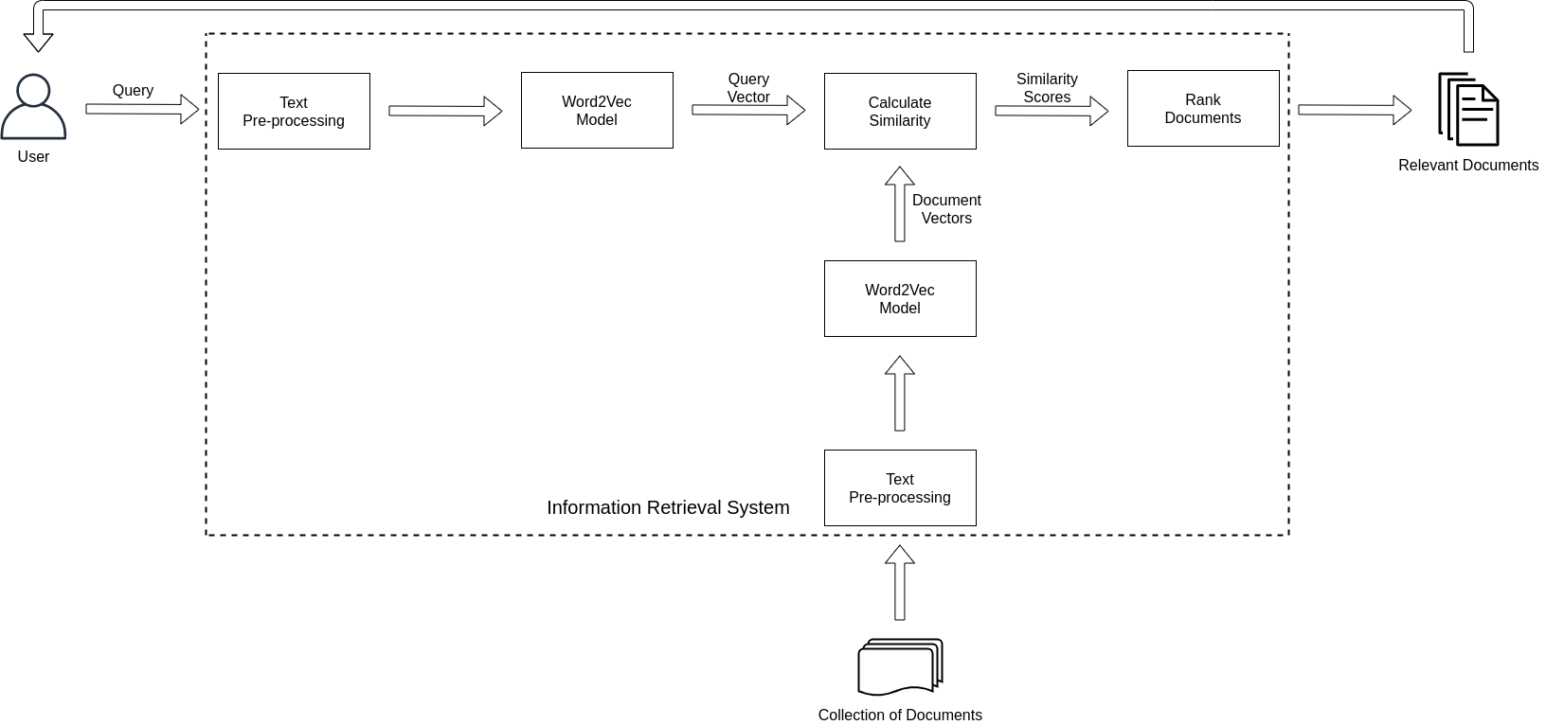
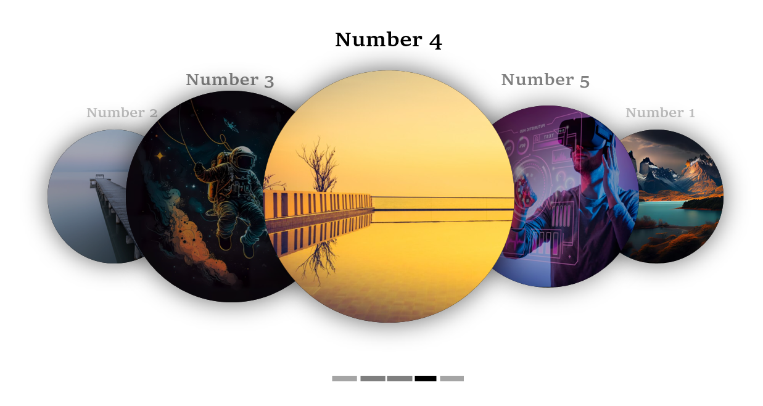

Slide 21

Applications
Can automate data preprocessing in machine learning and data science applications
Automate boring jobs of a business/data analyst
Scan for security vulnerabilities public reposited codes

Slide 22
Current Limitations
Slow information retrieval as full language space is covered
Can't be called as a real time continuous pipeline

Slide 23

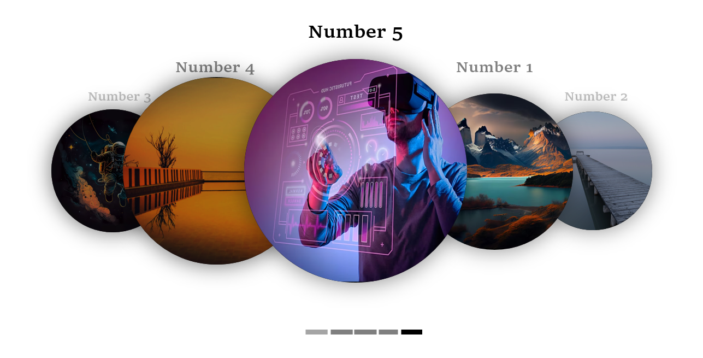
Future Scope
Update the design to include multiple algorithms to work together to improve efficiency
Add option to specify file format like csv, spreadsheet, databases as user requirements
Use specific space linguistic model to enhance speed.

